Slide 1
Piggybacking on Alameda County Contracts
Green Purchasing Roundtable
June 4th, 2014

Slide 2
Welcome!
Overview
Karen Cook, Alameda County GSA
The Environmental Perspective
Timonie Hood, U.S. EPA Region 9
The County Perspective
John Glann, Alameda County GSA
The Vendor Perspective
Sean Marx, CEO Give Something Back
Notes:
Today we’re going to talk about piggybacking. We’re going to use our recently awarded office paper contract as an example to walk you through why you will want to piggyback on our contracts, what our process it, and how you might interact with our vendors.

Slide 3
Green Purchasing Roundtable
Leverage County’s experience to advance green purchasing in local public agencies
Provide a forum for peer sharing and learning
Serve as a resource and clearinghouse
Let us know how we can serve you better!

Slide 4
What is Piggybacking?
Using an existing publicly bid contract as a template to form your own, separate contract directly with the vendor
Agencies must do their due diligence to ensure contract meets their requirements

Slide 5
Benefits of Piggybacking
Save time
Access competitive pricing
Know that the vendor is capable

Slide 6
Finding Contracts
http://www.acgov.org/index.htm

Slide 7
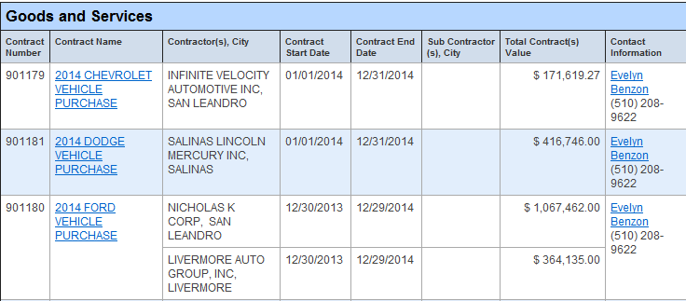
Available Contracts
http://www.acgov.org/gsa_app/gsa/purchasing/bid_content/closedbids.jsp

Slide 8
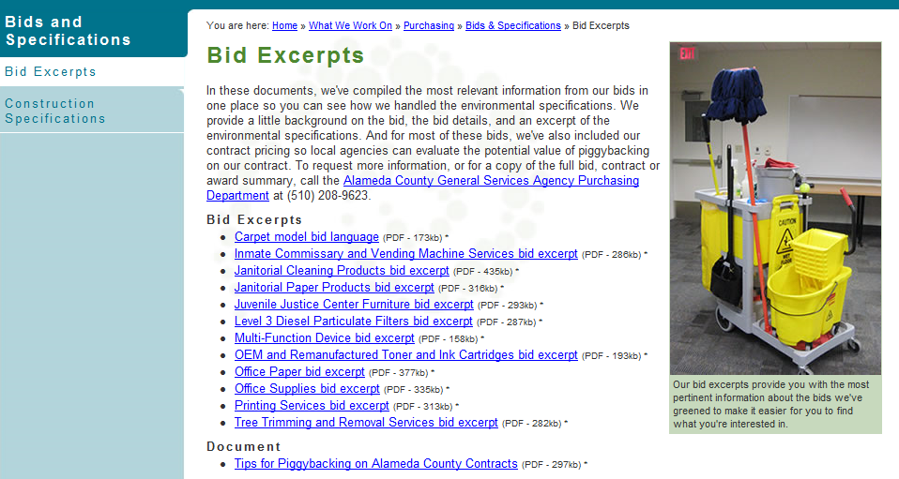
How Can You Learn More About Green Contracts?
http://www.acgov.org/sustain/what/purchasing/bids/excerpts.htm

Slide 9
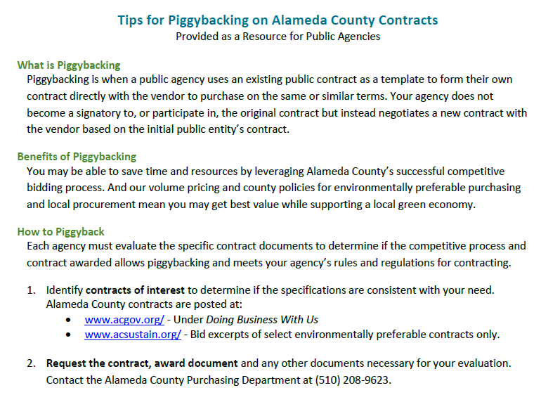

Slide 10
How did we get here?
Notes:
Thank you, Timonie, for sharing with us the importance of purchasing high recycled content paper.
Now I would like to share with you how the County ended up here, on this call with you, talking about our office paper contract.

Slide 11
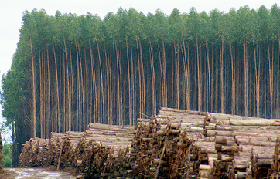
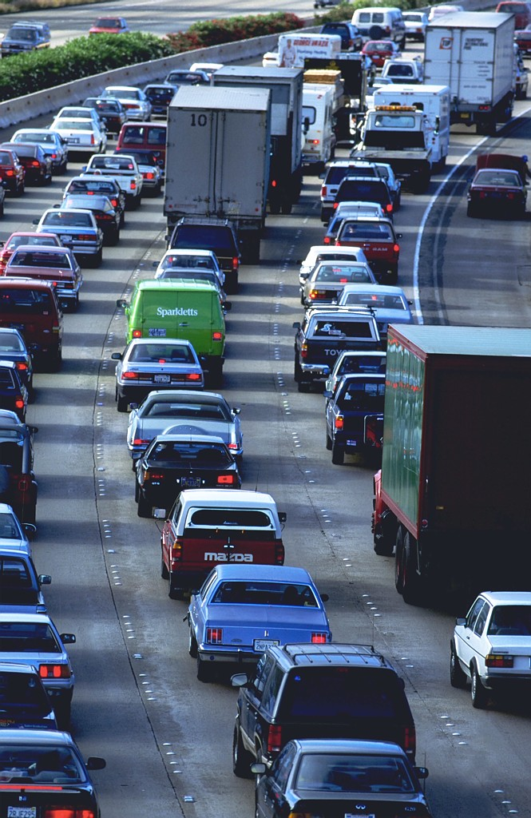
Small Change, Big Impact
By switching all County purchases to 100% recycled paper, each year we could:
Save 6,000 trees from being cut down
Reduce emissions equivalent to removing 200 cars from the road for one year
Environmental benefit estimates were made using the Environmental Paper Network Paper Calculator.
Notes:
We identified several years back that moving to 100% recycled content paper would have a beneficial impact on our climate and green purchasing efforts.
[Summarize slide information]

Slide 12
Recycled content over time
*8.5 x 11 regular white office paper only
Notes:
So why didn’t we make the switch right away? As you can see here, only in the last year has there been any significant use of the 100% recycled paper. It turns out that the 100% recycled paper was about $6 more than the 30% recycled paper on the previous contract, making it a tough sell for agencies to make the switch. So we decided to focus on paper use reduction as a long term strategy to neutralize the cost of moving to 100% recycled content paper. Well, this strategy work. Through education programs on topics like duplex printing and institutional changes like moving to e-records, we have been able to reduce paper use since it’s peak in 2009. And more of our purchases have gone to 100% recycled content paper.

Slide 13
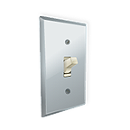
Institutionalize changes
Exclusively bid out 100% recycled content paper to obtain best price
Continue to actively support paper use reduction efforts
Notes:
But these changes have been incremental, and they have required a significant amount of staff time. So we knew that we needed to institutionalize the changes to make a more significant difference. So we engage a wide variety of stakeholders to gain support for developing a bid solicitation that moved the County’s purchasing volume for regular copy paper to exclusively 100% recycle paper in order to ensure vendors provided the best possible price for this product.

Slide 14
We received great pricing!
Previous contract
30% post-consumer recycled was $35.32/case
100% post-consumer recycled was $41.31/case
New contract
100% post-consumer recycled is $37.50/case
Notes:
The result?
We received great pricing for the product!
[summarize slide information]

Slide 15
Piggyback clause
Notes:
This bid was developed with you in mind.
In December 2012, we solicited feedback from Roundtable members on their interest in a collaborative contract. We heard from you that you would like to be able to consider piggybacking, but were not ready to commit to a fully collaborative contract process that committed you to participating.
So we issued a bid that made it clear to the bidders that we intended to share the relevant contract information with local public agencies, but that there was no guarantee of participation. This is the language we included in the in the bid and the contract.

Slide 16
Bid process details
Request for Interest- RFI (http://www.acgov.org/gsa_app/gsa/purchasing/bid_content/contractopportunities.jsp)
Posted to the website for 319 days
41 Respondents
Request for Quotation - RFQ (http://www.acgov.org/gsa_app/gsa/purchasing/bid_content/closedbids.jsp)
Posted to website 57 days
2 bidders
2 Bidders conferences held
Solicitation was advertised
Notes:
Those of you on the call who engage directly in contracting will want to know more about how we conducted the solicitation. Here are some of the relevant details about our process.
The RFI notifies the community that we intend to go out to bid for the services described.
The RFQ is the bid document. Evaluation is based solely on cost.

Slide 17
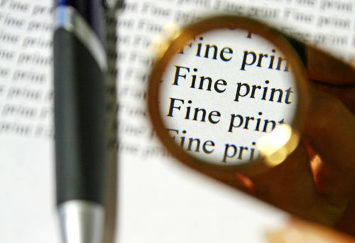
County provisions
Bid open to Small, Local and Emerging Business (SLEB) only (http://www.acgov.org/auditor/sleb/)
Awarded contractor must participate in First Source Program (http://www.acgov.org/auditor/sleb/sourceprogram.htm)
Notes:
The County has a strong commitment to ensure that all local businesses are given an opportunity to contract with the County and promote the economic growth of the community. To do this, we have two provisions that apply to most procurements of goods and services.
The small, local and emerging business program (known as SLEB) provides up to 10% in preference points for certified business. The County’s auditor’s office manages this program and certifies business.
The first source program links Alameda County residents with employment opportunities provided through the County's relationships with businesses, including contracts that have been awarded to vendors through the competitive process, and economic development activity in the County.

Slide 18
54 Products on contract
Regular white copy paper
3 sizes and 3-hole punch
Heavy weight copy paper
24 lbs, 28 lbs, etc.
Colored copy paper
Various colors and thickness
Specialty papers
Greenbar and perforated

Slide 19
Questions?
For Green Purchasing Info:
Karen Cook
Sustainability Project Manager
Karen.Cook@acgov.org
510-208-9754
To Request Bid Documents:
Gina Temporal
Contract Specialist
Gina.Temporal@acgov.org
510-208-9606

